Slide 1
Blog Coursework

Slide 2
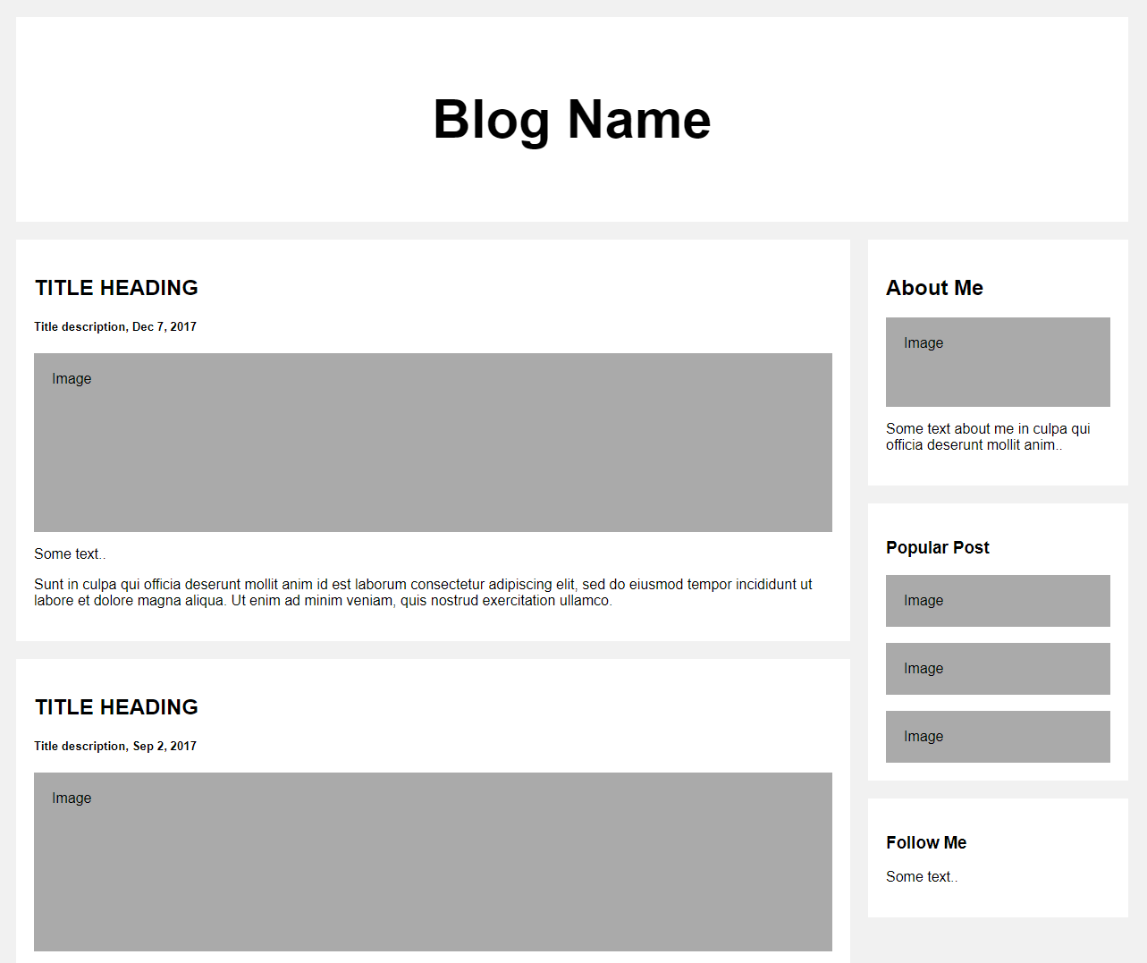
Template from w3 schools

Slide 3
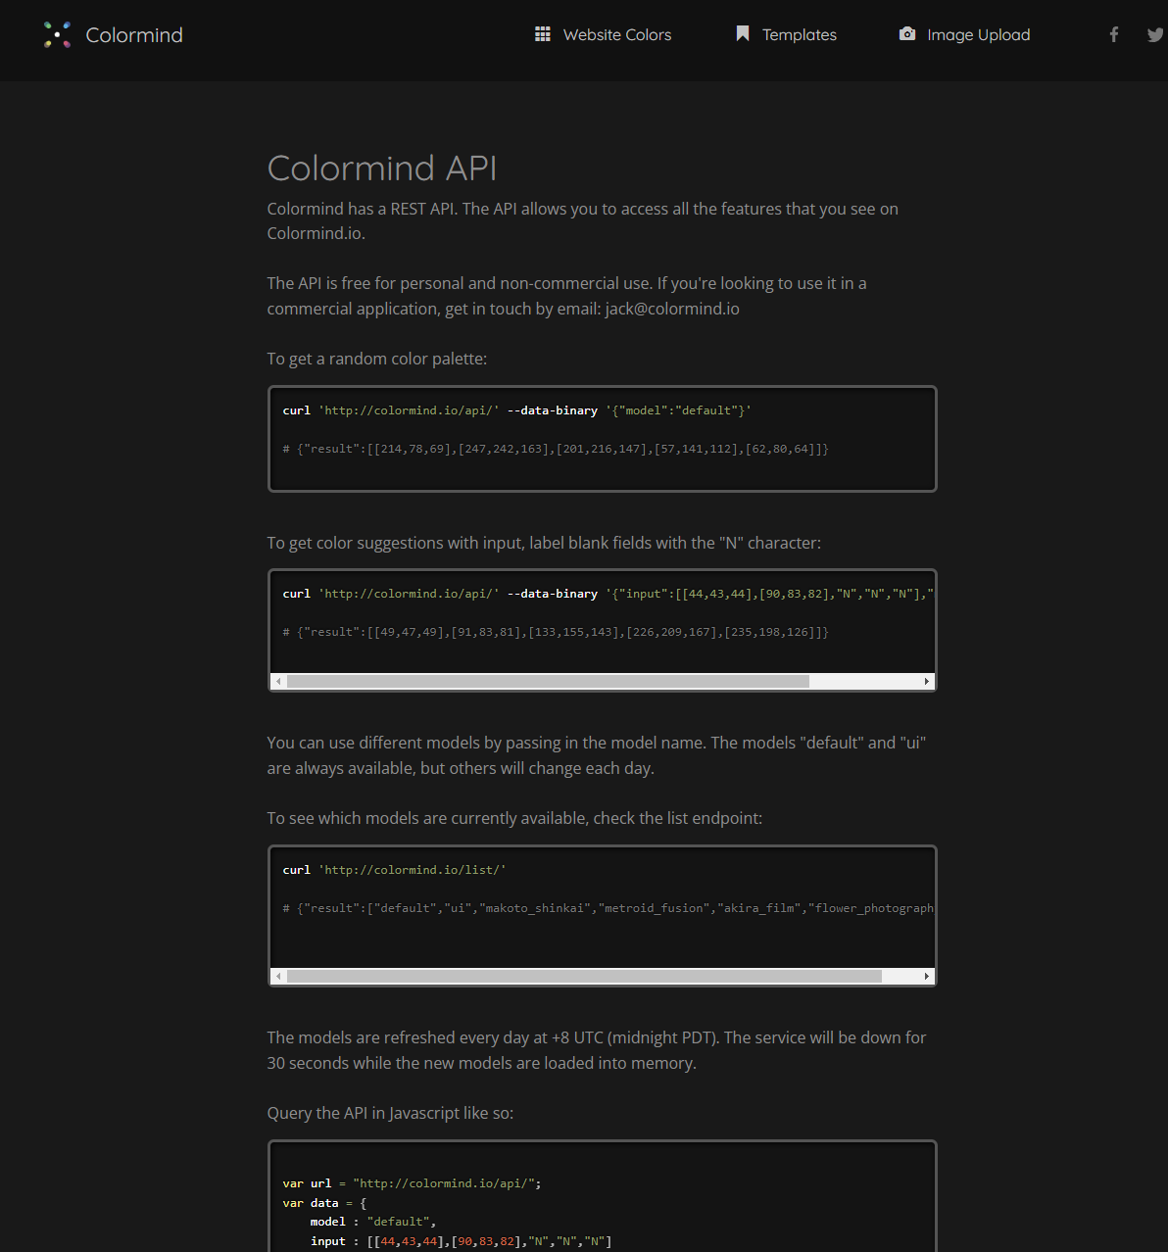
API
http://colormind.io/api-access/

